Slide 1
CSE176e/276e: Robotic Systems Design and Implementation
To achieve great things, two things are needed: a plan and not quite enough time.
--Leonard Bernstein
Homepage: http://goo.gl/XYwuoy

Slide 2

Course Goals
Build a small quadcopter
In 10 weeks
Mostly “from scratch”
Learn
Moderately complex PCB design
Basic sensing and control

Slide 3
Course Schedule Outline
Main goal: Start testing/refining flight control software on your quadcopter ASAP.
Weeks 1-5: Sprint to a PCB design, do preliminary software development
Most important date: April 30th – Board “tape out”
Weeks 5-10: Software refinement, quad assembly, refinement and testing.
Schedule is here: https://goo.gl/cNkR3C

Slide 4
Lab Logistics

Slide 5
Teams
You will work both in groups and on your own
The first two Eagle labs will be on your own.
The rest are completed in pairs of your choosing.
In all cases, you can help each other out
No direct copying of source code, designs, etc.
Asking questions, etc. is great.
There is no curve in this class – no need to compete.

Slide 6
Lab Overviews

Slide 7

Introduction To Eagle
Build design a simple schematic.
Turn it into a board design.
Generate manufacturing data.
Performance manufacturing checks.
Design some new parts for the Eagle library.
Learn to decorate your boards.
This is due Thursday (in 36 hours!!!)

Slide 8
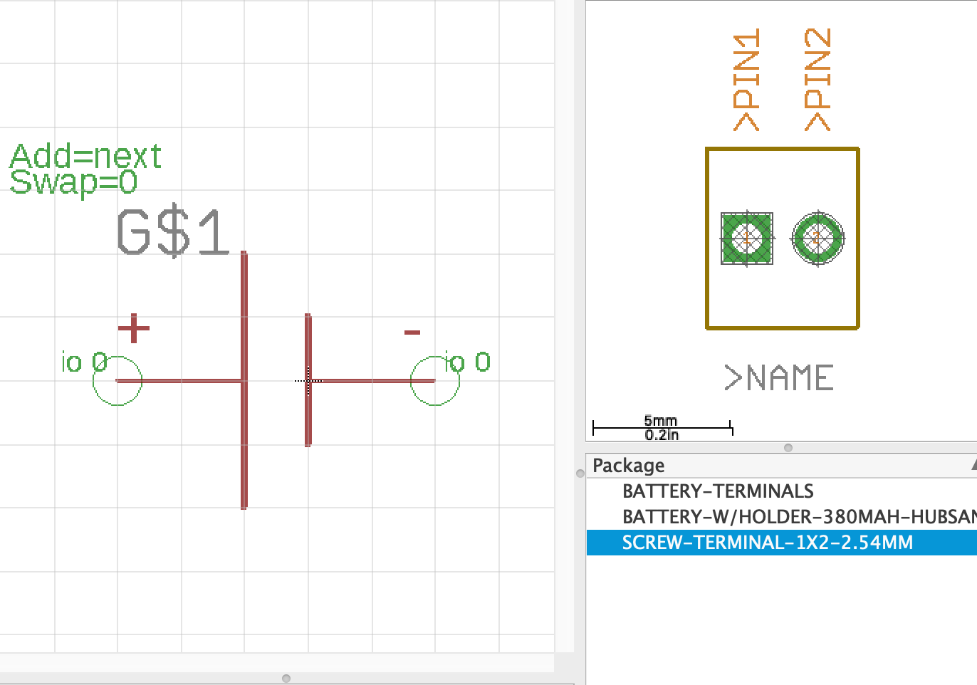
Building Part Libraries in Eagle
Build some parts in Eagle
Learn about PCB libraries

Slide 9
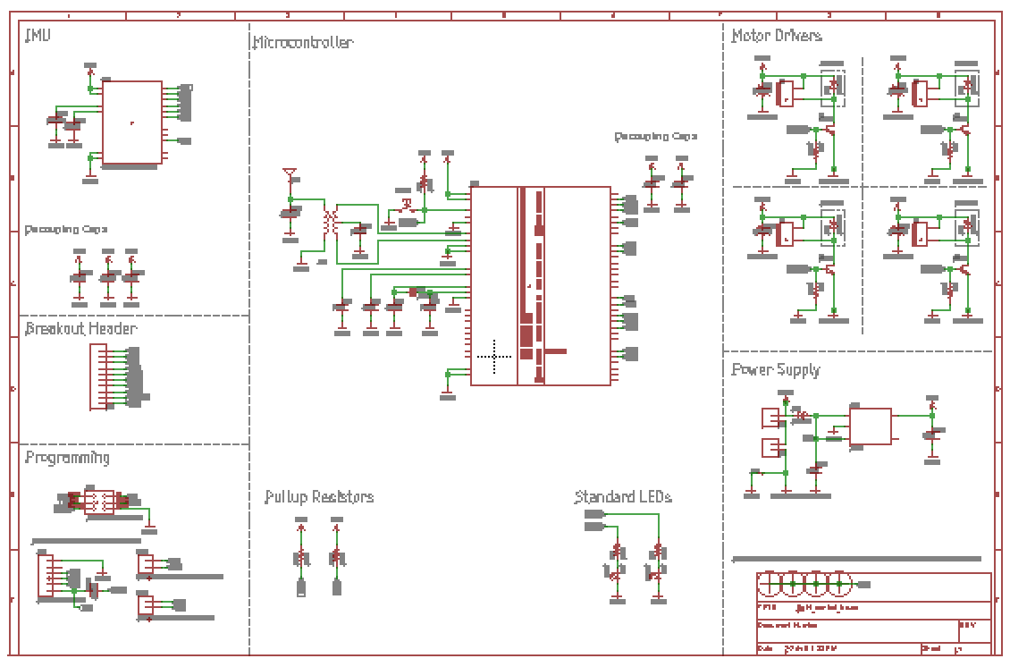
Building The Quadcopter Schematic
Start with a blank sheet.
Build the design by…
Looking at reference designs
Reading datasheets
Interpreting a written spec
Designing from scratch

Slide 10
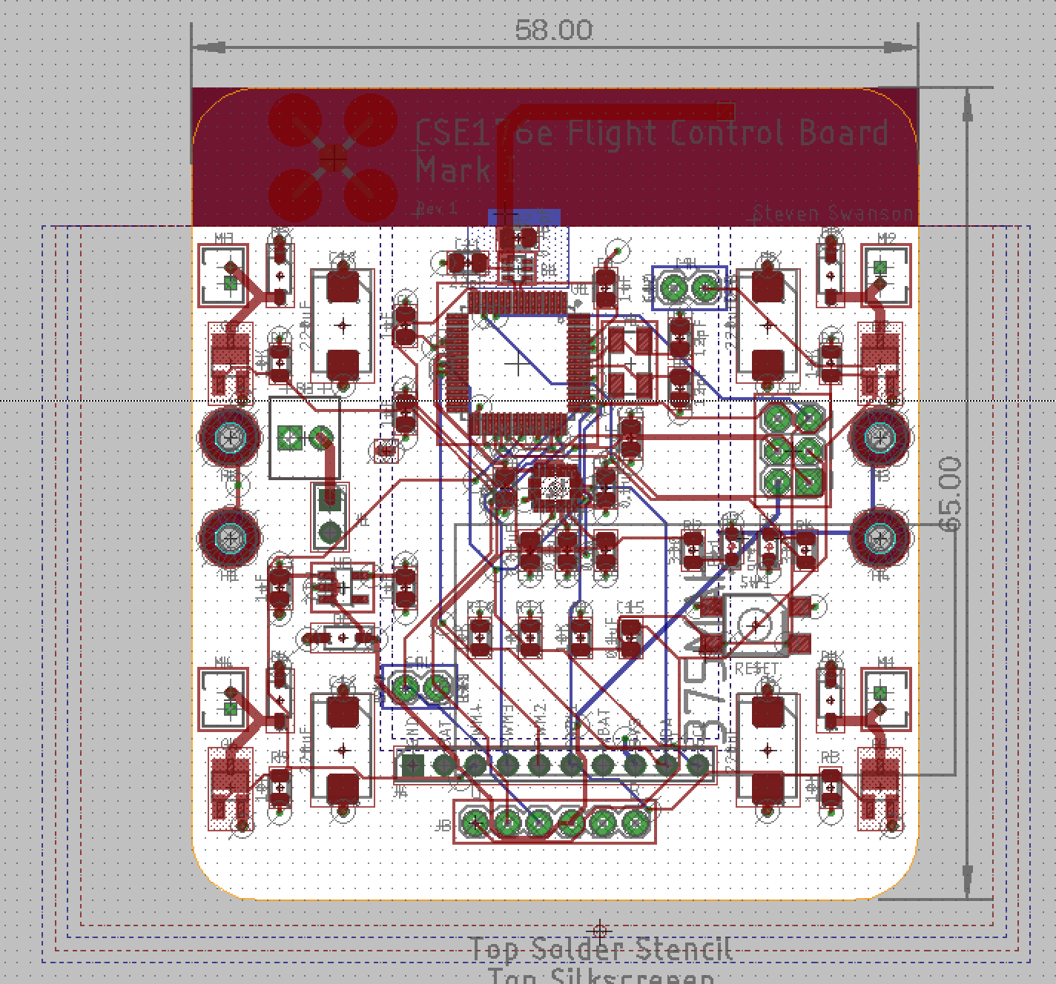
Laying Out The Board
Initial layout
Define the board outline.
Place your parts.
Route the design.
Peer Design Review

Slide 11
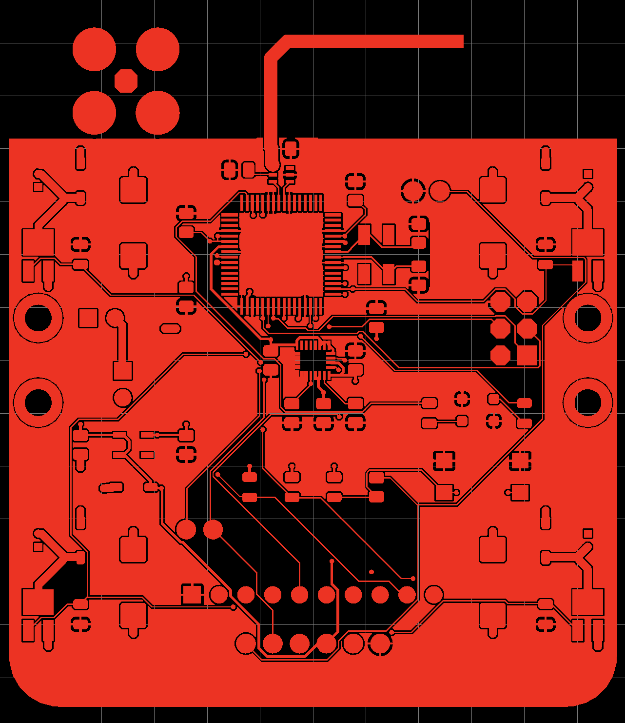
Manufacturing The Board
Your designs must be ready for manufacturing by the beginning of class on May 10th.
Early tape out is possible on May 8th.
It will take about a week to manufacture them.

Slide 12
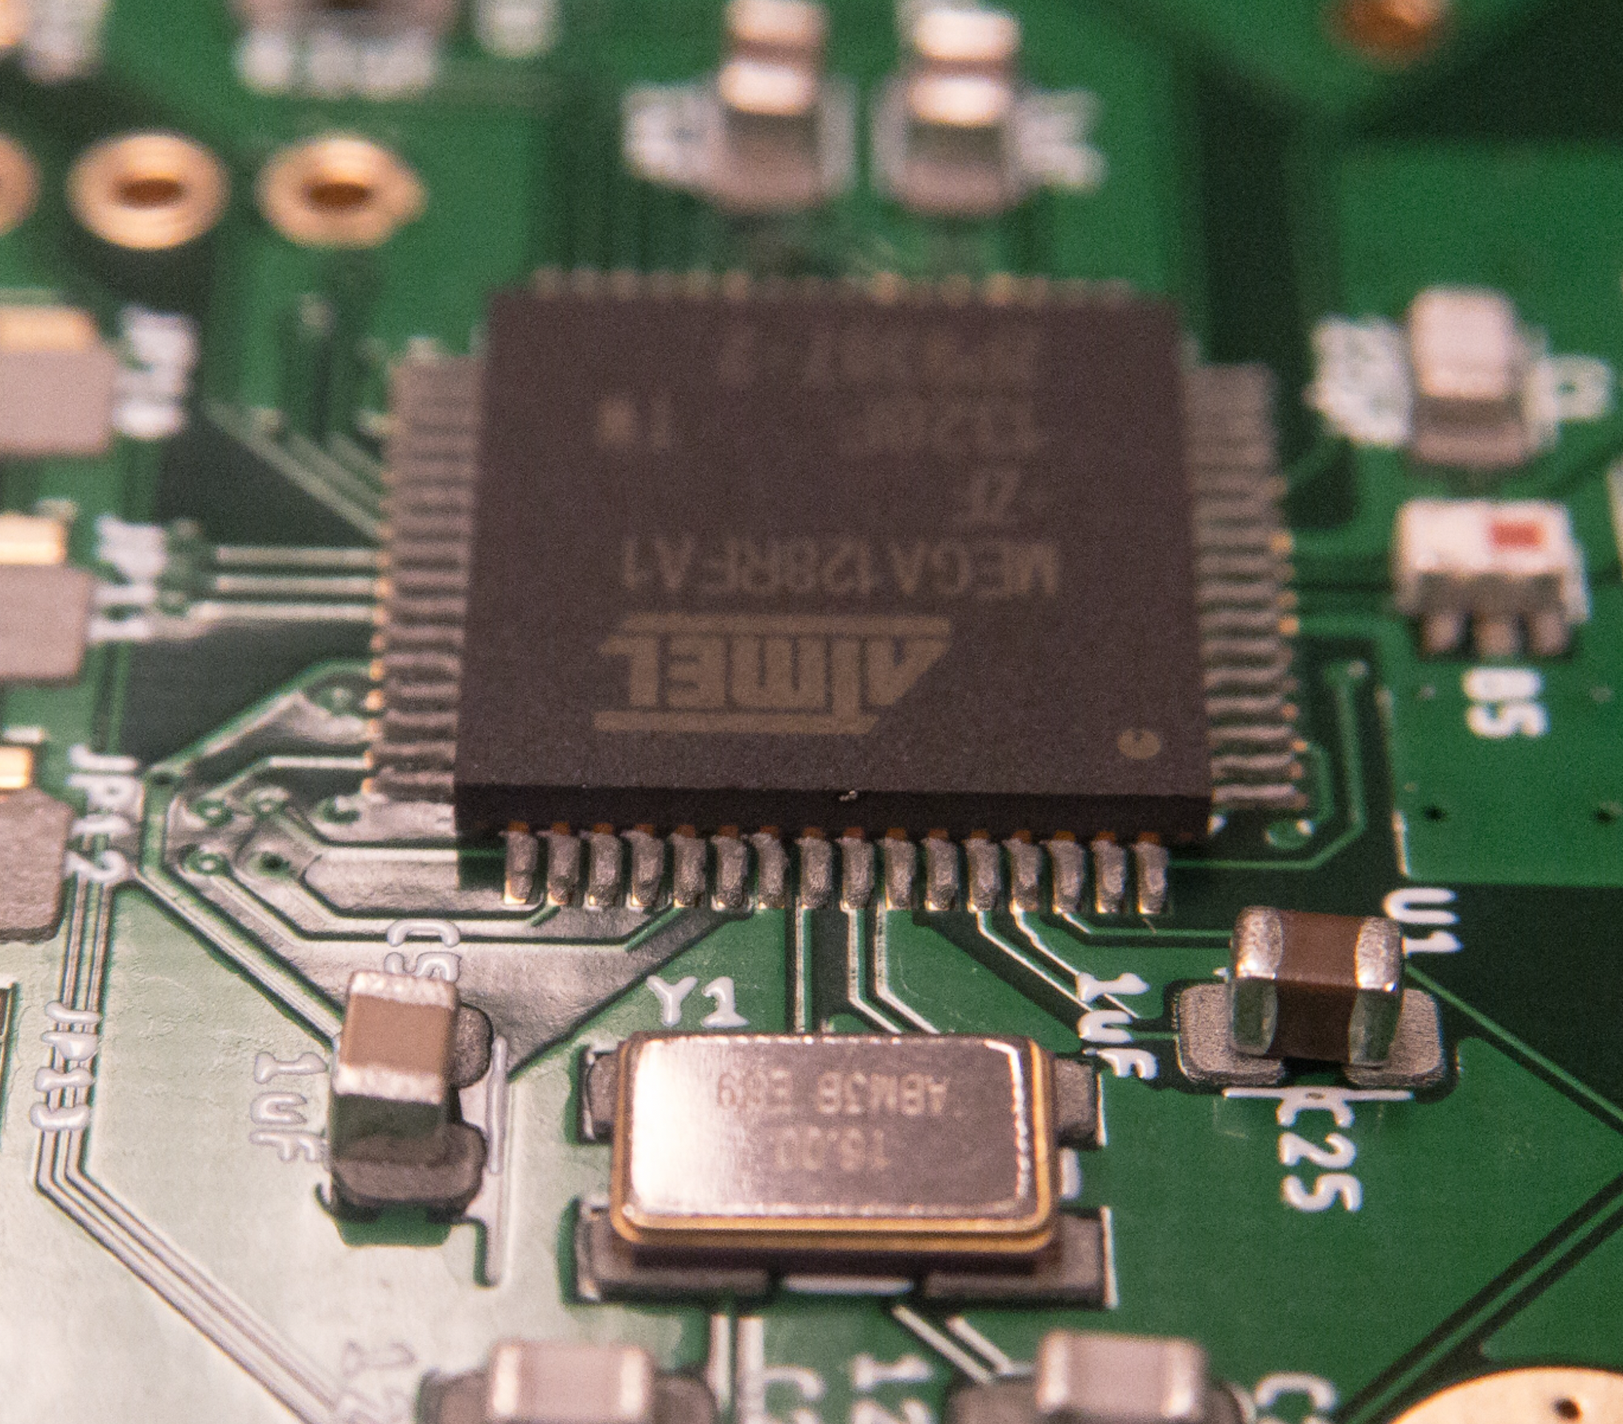
Assembling A PCB
Solder everything to a board
Install the bootloader
Test all the board’s parts.
This is hard, so we will do it twice
1st time: Very simple board, very soon
2nd time: Your quadcopter, when it’s ready

Slide 13
Programming the Hardware
Assemble and use all the test stand and remote
Get all software basics working
Measure gimbals
Measure orientation with the IMU
Communicate wirelessly

Slide 14
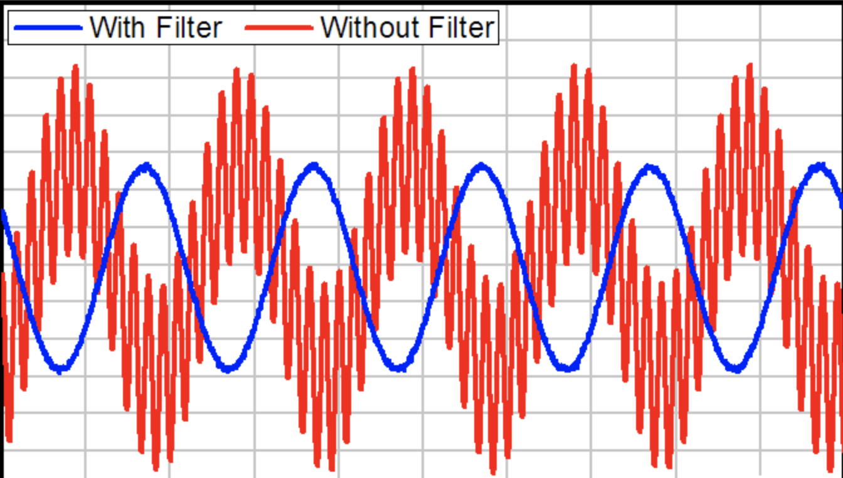
Sensing and Filtering
Accurately measure orientation on the test stand
Filtering IMU output in hardware and software.

Slide 15
Implementing PID
Implement one channel of PID to keep the test stand steady.

Slide 16
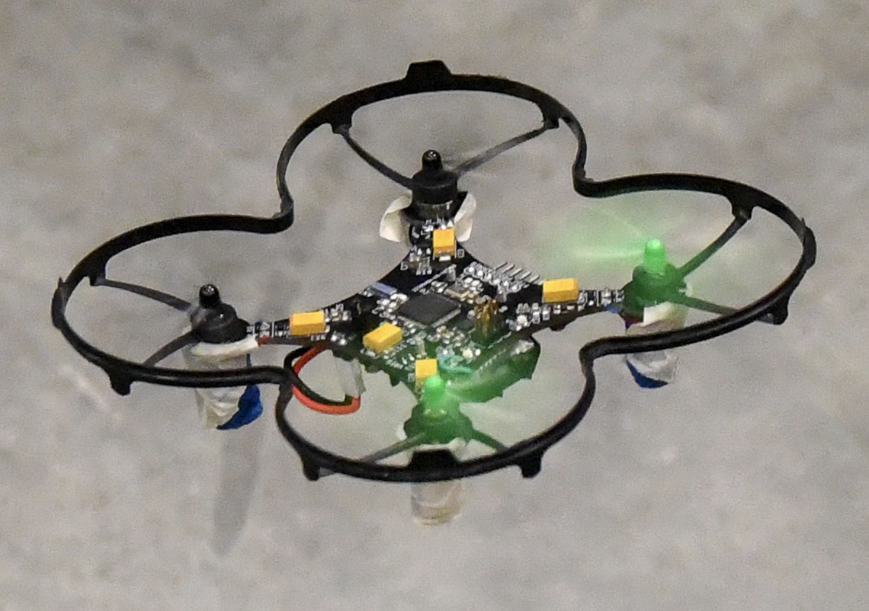
Flight
Extend PID to 3 channels
Implement flight control details
Test, adjust, tweak, debug, etc. until its flight is stable.

Slide 17
Cleanup
Turn in hardware

Slide 18
The Lab Schedule
The lab schedule is very aggressive
We start a new lab every day!
The early weeks there will some times be 3 labs going on at once.
Do not fall behind!

Slide 19
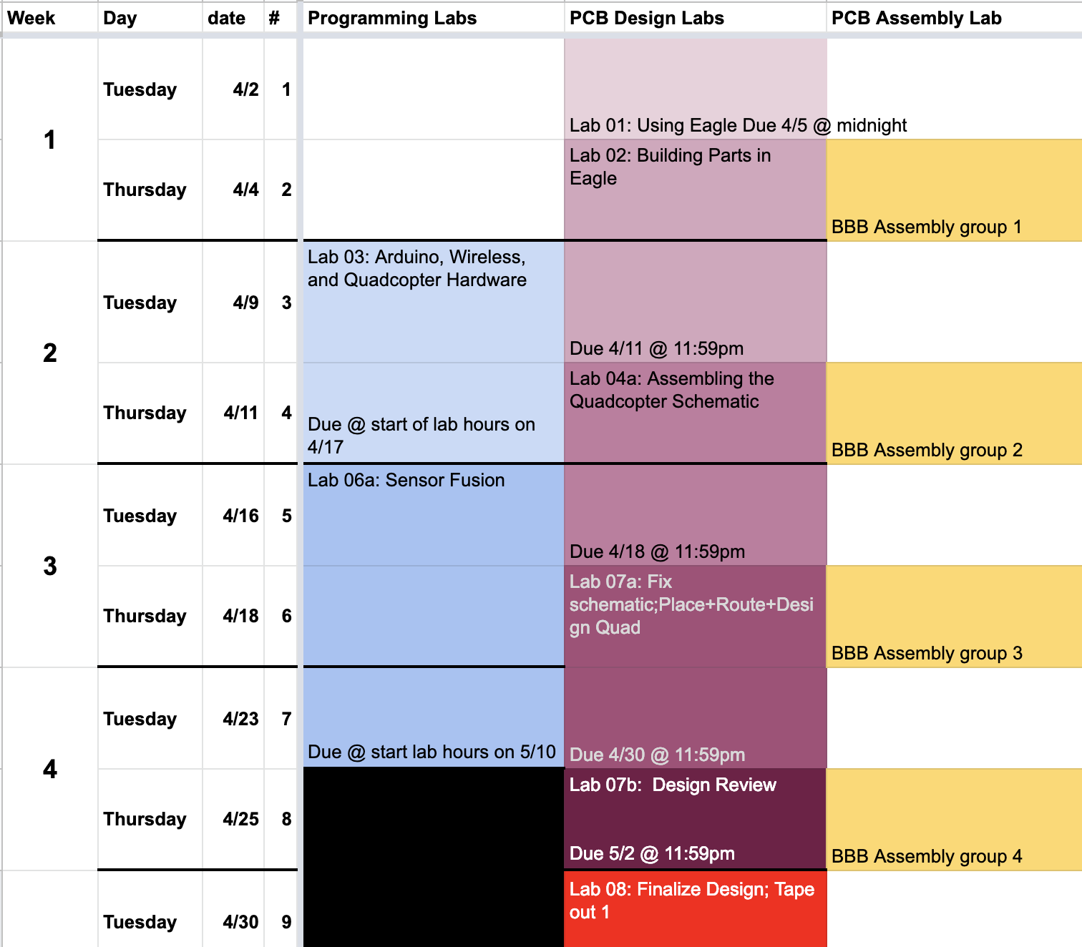
Schedule
The lab schedule is very aggressive
We start a new lab every day!
Sometimes you will work on 3 labs at once.
Do not fall behind!

Slide 20
Logistics

Slide 21
Lab Materials
We will distribute lab materials via github classroom.
You’ll need a github account.
You’ll need to know how to use git.
To access the lab materials, click on the invitation link included in each lab.

Slide 22
Grades and Stuff
No final or exams.
Grading breakdown
50% class participation
50% labs

Slide 23
This is an Intensive, Hands-on Class
Not so much lecturing
Lots of doing.
Your Task
Work Hard
Figure stuff out
Take the initiative
Course Staff Task
Provide high-level guidance
Solve problems
A few lectures
Make sure you have what you need to succeed.

Slide 24
Lab Space
We will meet and work in this room (EnVision -- SME)
You must complete the responsibility contract: http://makerspace.ucsd.edu/access/responsibility.php
Class: 11-12:30
Lab hours
12:30-2:00 on Tuesday and Thursday
Other times TBD

